Slide 1

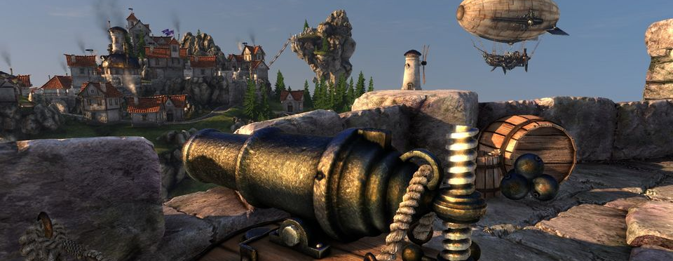
The Input Assembler
Dr. Jake Habgood
Room 9342 Cantor Building
J.Habgood@shu.ac.uk

Slide 2
THE PRACTICE ASSIGNMENT!

Slide 3
The Practice Assignment
Assignment 1
You don’t need to be stressed!
It’s just about getting you to spend time “warming up” for the module
but you wouldn’t do that if you weren’t offered marks ☺
I hope you have been busy...
but.. I wouldn’t be surprised if everyone got 8/8 marks ☺ ☺ ☺
I’m not trying to catch you out
The early assignment and tutorials are all there to HELP you..
The main assignment is where student marks on the module are differentiated
GDI+
BTW: The GDI doesn’t have to be as slow as this... (look at the “Present” function)
There is a connection between the kinds of tasks you’ve been doing in this practice assignment and the next tutorial we’re doing today...

Slide 4
RECAP
Open the BasicD3D11 Solution

Slide 5
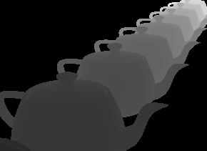

Recap
Pipeline
Output Merger Stage (OM)
We created a Device, DeviceContext, SwapChain and Depth Buffer and bound the RenderTarget to the Output Merger stage of the pipeline ready to be rendered to
m_pD3DDeviceContext->OMSetRenderTargets(…)
Input Assembler
Vertex Shader
Rasteriser
Pixel Shader
✓
Output Merger

Slide 6
The INPUT ASSEMBLER
A three stage process:
1. Vertex format
2. Vertex buffers (and index buffers)
3. Primitive topology
X3
Input Assembler

Slide 7
The Input Assembler
Pipeline
Input Assembler Stage (IA)
Reads geometric data from memory (e.g. vertices) and uses it to assemble geometric primitives (e.g. triangles)
y
(2, 3)
(1, 2)
Input Assembler
Vertex Shader
(3, 1)
x
Rasteriser
Pixel Shader
There are conceptually 3 parts to this....
✓
Output Merger

Slide 8
PART 1. VERTEX FORMATS
1
Input Assembler

Slide 9
Vertex Formats
Vertex Structures
More than just a point
Position, colour, normal, texture co-ordinates
For example our BasicD3D11 vertex structure: struct SimpleVertex
{
XMFLOAT3 pos;
XMFLOAT4 colour;
}
The struct tells the C++ compiler how to organise our data in memory, but DirectX needs to be told what each element means and how to access it
It can’t just read your code to work it out!
NOTE: This layout is not very well aligned and could be improved.
BasicD3D11.cpp Line 32+

Slide 10
Vertex Formats
R32G32B32 is not a typo: you really do use the RGB format specifier for position and normal values. All DirectX cares is that it is 3 dimensional and each dimension is represented by a 4 byte floating point value
Vertex Formats
Informing DirectX
D3D11_INPUT_ELEMENT_DESC
SemanticName (+SemanticIndex) is a string representing a variable name for this element used in the vertex shader
Format specifies the data format of the element e.g.
DXGI_FORMAT_R32G32B32_FLOAT
DXGI_FORMAT_R32G32B32A32_FLOAT
InputSlot advanced feature set to 0
AlignedByteOffset is the offset in bytes from the start of the vertex structure to the start of the current element
InputSlotClass and InstanceDataStepRate are advanced features set to default values for now
Used for our position
Used for our colour

Slide 11
Vertex Formats
Vertex Format Descriptor
E.g
BasicD3D11.cpp Line 487+
D3D11_INPUT_ELEMENT_DESC layout[] = {
{"POSITION", 0, DXGI_FORMAT_R32G32B32_FLOAT, 0, offsetof(SimpleVertex, pos), D3D11_INPUT_PER_VERTEX_DATA, 0},
{"COLOUR", 0, DXGI_FORMAT_R32G32B32_FLOAT, 0, offsetof(SimpleVertex, colour), D3D11_INPUT_PER_VERTEX_DATA, 0},
};
offsetof() is a macro that obtains the byte offset of a structure member by name. This is safer than working it out yourself (which is the approach in the original code!)

Slide 12
Vertex Formats
Vertex Formats
InputLayout
CreateInputLayout(…)
pInputElementDescs is an array of the element descriptors
NumElements is the number of elements in the array
pShaderBytecodeWithInputSignature
ByteCodeLength
ppInputLayout (returned)
Then bind it to the device
m_pD3DDevice->IASetInputLayout(…)
BasicD3D11.cpp Line 500+
These allow Direct3D to make a mapping between the vertex structure and shader inputs upon creation. That is why you’ll see this code within the CompileShaders() function in D3DHelpers.cpp
1
✓
Input Assembler
Vertex Shader
Rasteriser
Pixel Shader
Output Merger

Slide 13
PART 2. VERTEX BUFFERS
2
Input Assembler

Slide 14
Vertex Buffers
Vertex Buffers
ID3D11Buffer
D3D11_BUFFER_DESC
ByteWidth is the size of the buffer to be created
Usage can be:
D3D11_USAGE_DEFAULT for GPU r/w access only
D3D11_USAGE_IMMUTABLE for GPU read access only
D3D11_USAGE_DYNAMIC for r/w by CPU + GPU
D3D11_USAGE_STAGING for read by CPU + r/w by GPU
BindFlags set to D3D11_BIND_VERTEX_BUFFER.
CPUAccessFlags set to D3D11_CPU_ACCESS_WRITE or D3D11_CPU_ACCESS_READ to match Usage above.
MiscFlags set to 0
BasicD3D11.cpp Line 522+

Slide 15
Vertex Buffers
Vertex Buffers
ID3D11Buffer
D3D11_SUBRESOURCE_DATA
A pointer to the memory that should be used to initialise the vertex buffer with.
Call ID3D11Device::CreateBuffer()
Then bind it to the device
m_pD3DDevice->IASetVertexBuffers(…)
2
✓
Input Assembler
BasicD3D11.cpp Line 531
Vertex Shader
Rasteriser
Pixel Shader
✓
Output Merger

Slide 16
PART 3. PRIMITIVE TOPOLOGY
3
Input Assembler

Slide 17
Primitive Topology
Primitive Topology
IASetPrimativeTopology
A vertex buffer is just a bunch of points – DirectX can interpret those points in a number of ways.
How they are interpreted is called their primitive topology
D3D11_PRIMITIVE_TOPOLOGY
Bind it to the device
m_pD3DDevice->IASetPrimitiveTopology(…)
3
✓
Input Assembler
BasicD3D11.cpp Line 564
Vertex Shader
Rasteriser
Pixel Shader
✓
Output Merger

Slide 18
Primitive Topology
Primitive Topology
7.
1.
3.
5.
4.
6.
8.
2.
0.
D3D11_PRIMITIVE_TOPOLOGY_POINTLIST
7.
1.
3.
5.
4.
6.
2.
0.
D3D11_PRIMITIVE_TOPOLOGY_LINELIST

Slide 19
Primitive Topology
Primitive Topology
7.
1.
3.
5.
4.
6.
8.
2.
0.
D3D11_PRIMITIVE_TOPOLOGY_LINESTRIP
3.
7.
1.
5.
4.
6.
8.
2.
0.
D3D11_PRIMITIVE_TOPOLOGY_TRIANGLESTRIP

Slide 20
Primitive Topology
Primitive Topology
7.
1.
3.
5.
4.
6.
8.
2.
0.
. 3
D3D11_PRIMITIVE_TOPOLOGY_TRIANGLELIST
This is the one we are using in the Heightmap example. Every triangle has three vertices even when these vertices are duplicated between triangles. Not the most efficient setup!
2.
1.
4.
0.
5.
D3D11_PRIMITIVE_TOPOLOGY_TRIANGLELIST_ADJ

Slide 21
Index Buffers
Index Buffers
An array of Indices
indexList[7] = {
0, 1, 2, // Triangle 1
2, 1, 3, // Triangle 2
2, 3, 4, // Triangle 3
… // etc.
}
3.
7.
1.
5.
4.
6.
8.
2.
0.

Slide 22
Index Buffers
Index Buffers
ID3D11Buffer
D3D11_BUFFER_DESC
Created in the same way as a Vertex Buffer
Call ID3D11Device::CreateBuffer()
Except BindFlags set to D3D11_BIND_INDEX_BUFFER.
Bind it to the device
m_pD3DDevice->IASetIndexBuffer(…)
✓
Input Assembler
BasicD3D11.cpp Line 561
Vertex Shader
Rasteriser
Pixel Shader
Output Merger

Slide 23
TUTORIAL
Heightmap - Week 1

Slide 24
OUR APP FRAMEWORK
open Heightmap.sln in Visual Studio 2017

Slide 25
Our App Framework
Games Are Like Onions
Windows
Games programmers traditionally disliked Windows programming because it stood between them and the hardware (performance)
Hard to give up understanding and control of how your game works
Get used to it!
App Framework
Created by Tom Seddon (ex-Sumo)
Makes your life easier (for the most part)
Once you understand it you can rewrite it if you want to
Game
Game Engine
App Framework
XNA
.NET
DirectX
Win32 API
Kernel
Hardware

Slide 26
Our App Framework
Maths Libraries
DirectXMath is the newer and recommended math library.
If you have used D3DXMath in the past then (DON’T in FUTURE):
D3DXVECTOR2 => XMFLOAT2 D3DXVECTOR3 => XMFLOAT3 D3DXVECTOR4 => XMFLOAT4 D3DXMATRIX => XMMATRIX (ish)
See: https://tinyurl.com/Working-with-D3DXMath

Slide 27
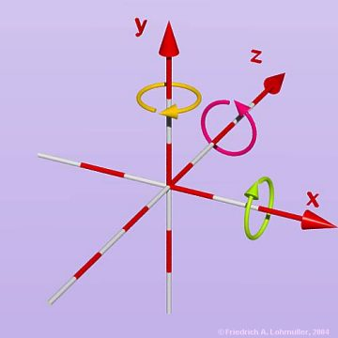
Our App Framework
DirectXMath Matrices
4x4 Matrix
union XMFLOAT4X4
{
union { struct {
float _11, _12, _13, _14;
float _21, _22, _23, _24;
float _31, _32, _33, _34;
float _41, _42, _43, _44; };
float m[4][4];
};
};

Slide 28
Our App Framework
DirectXMath Matrices
Aligned Matrix
struct XMMATRIX mMyMatrix.r[0]
{ mMyMatrix.r[1]
XMVECTOR r[4]; mMyMatrix.r[2]
}; mMyMatrix.r[3]
typedef __m128 XMVECTOR;

Slide 29
Our App Framework
Maths Libraries
DirectXMath
XMVECTOR is a typedef of __m128;
Convert from XMFLOAT to XMVECTOR: (SIMD Load)
XMLoadFloat3( XMFLOAT3* pSource );
Convert from XMVECTOR to XMFLOAT : (SIMD Store)
XMStoreFloat3( XMFLOAT3* pDest, XMVECTOR v );
See: https://tinyurl.com/DirectXMath-Getting-Started
Rule of thumb : store XMFLOATs , convert to XMVECTOR for calculations.
Luna’s DX11 Book covers this in some detail and provides examples.

Slide 30
Our App Framework
DirectXMath
Memory Alignment
Classes that contain XMVECTOR and XMMATRIX data members must be memory aligned themselves:
__declspec(align(16)) class Cube {
This tells the compiler to align to 16 byte boundaries, but the compiler can only do this for data which is static or allocated on the stack. It doesn’t work for dynamic data allocated on the heap (i.e. with new).
“warning C4316: Cube' : object allocated on the heap may not be aligned 16”

Slide 31
Our App Framework
DirectXMath
Memory Alignment
__declspec(align(16)) class Cube {
public:
XMMATRIX m_mMatrix;
void* operator new(size_t i) {
return _mm_malloc(i,16);
}
void operator delete(void* p) {
_mm_free(p);
}
};
Already added to tutorial code, but don’t forget your own classes!

Slide 32
Our App Framework
Maths
DirectXMath vs. D3DXMath/SimpleMath
Tom’s App Framework originally used D3DXMath
It has been updated to support DirectXMath, so that you can use the most current approach in all of your code (and the tutorials).
Some of the ‘deeper’ sections still use the original method (it’s due an overhaul for next year)
Use DirectXMath in all of your tutorials and assignments – not D3DXMath (or wrapper libraries like SimpleMath)
You should be able to handle this
Rule of thumb: store XMFLOATs , convert to XMVECTOR for calculations (then you won’t need to worry about memory aligned classes)

Slide 33
Tutorial
Aims of Tutorial Sessions
3D Techniques FOR GAMES
The tutorial content of the module provides an applied focus for the topics studied in the lectures
Forms the basis of a simple game which brings together all of the topics studied in the module:
Fly around a landscape in an aeroplane shooting and dropping bouncing bombs on a giant animating robot
A tutorial based on initialisation would be even more dull than a lecture on one ☺
So we’ll start by tackling the landscape in our game

Slide 34

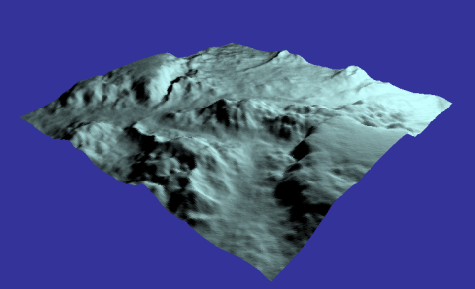
Tutorial
Heightmap Week 1
What is it
A two-dimensional array of values representing heights in a regular grid structure.
Often derived from a heightmap image where white = raised and black = lowered
0.
1.
2.
3.
4.
5.
6.
7.
8.
9.
10.
11.
12.
13.
14.
15.
16.
17.
18.
19.
20.
21.
22.
23.
24.

Slide 35
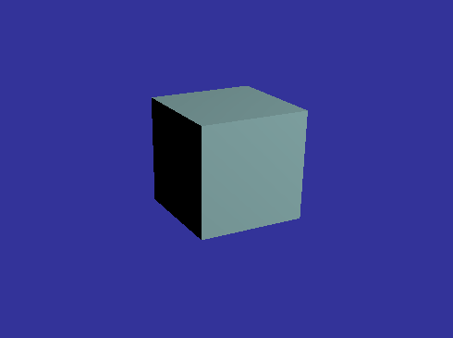
Tutorial
Heightmap Week 1
Week 1 Task
Alter the code so that rather than rendering a cube, it loads a heightmap from a file and renders that instead
Approach
There is only one function that need changing:
bool HeightMapApplication::HandleStart()
The area that needs attention is clearly marked by comments and there is no need to change anything else

Slide 36
Tutorial
Heightmap
Approach
Start with HandleStart()
Declare an array which is big enough for the heightmap
Look at the order in which vertices are used to define triangles in the cube – particularly for the top face
Heightmap data is loaded into the m_pHeightMap[] array by the LoadHeightmap function
Use that data to feed into your vertex data
Perhaps use an intermediary step?
v0 = m_pHeightMap[mapIndex];
v1 = m_pHeightMap[mapIndex+1];
v2 = m_pHeightMap[mapIndex+HeightMapWidth];
v3 = m_pHeightMap[mapIndex+m_HeightMapWidth+1];
Tweaked to reflect clockwise winding order (see next slide)

Slide 37
Tutorial
Heightmap
Triangle List
for x…
-1
+1
0.
1. 3
0.
1.
2.
3.
4.
2. 5
. 4
5.
6.
7.
8.
9.
+width
See note on final slide!
10.
11.
12.
13.
14.
You need a clockwise “winding order” to make your normals face outwards. It doesn’t make a big difference in this example as back-face culling is turned off, but it may come back to haunt you later if you expand on this tutorial
for y…
15.
16.
17.
18.
19.
-width
20.
21.
22.
23.
24.

Slide 38
Tutorial
Heightmap Week 1
Approach
Watch out for the edges (256*256 vertices = 255*255 quads)
Calculate the normals too!
Just one normal for used for all three vertices in each triangle (i.e. flat shaded)

Slide 39
TUTORIAL
Heightmap - Week 2

Slide 40
Tutorial
Heightmap Week 2
Recap
Started with a cube
Isolated the top face to form a plane
Introduced a loop to generate a larger plane
Sampled bitmap data to control the y values at each vertex to generate terrain
Generated normals per triangle for shading
Make sure you have done all this before proceeding…

Slide 41
Tutorial
Heightmap
Triangle List
for x…
-1
+1
0.
1. 3
0.
1.
2.
3.
4.
2. 5
. 4
5.
6.
7.
8.
9.
+width
See note on final slide!
10.
11.
12.
13.
14.
You need a clockwise “winding order” to make your normals face outwards. It doesn’t make a big difference in this example as back-face culling is turned off, but it may come back to haunt you later if you expand on this tutorial
for y…
15.
16.
17.
18.
19.
-width
20.
21.
22.
23.
24.

Slide 42
Tutorial
Heightmap Week 2
Week 2 Task
Convert the vertex buffer and topology to use a more efficient Triangle Strip rather than a Triangle List
Do not throw away your previous code as it is still the most straightforward way of calculating the normal (store them in a buffer)
Motivation
Amount of vertices required is proportional to image size squared
Space complexity: Big O = O(n²)
Pro: Reduced CPU overhead generating extra vertices
Pro: Reduced GPU bandwidth

Slide 43
Tutorial
Heightmap Week 2
Vertex Size
sizeof(Vertex_Pos3fColour4ubNormal3f) = 28 bytes
Triangle List
Vertex count = (IMAGE_HEIGHT -1) * (IMAGE_WIDTH -1) * 6 = 390,150
Vertex buffer size = 390,150 * 28 = 10,924,200 (~11MB)
Triangle Strip
Vertex count = (IMAGE_HEIGHT -1) * IMAGE_WIDTH * 2 = 130,560
Vertex buffer size = 130,560 * 28 = 3,655,680 (~3.6MB)
A saving of ~7.2MB in our case, but what if the image was bigger?

Slide 44
Tutorial
Heightmap Week 2

Slide 45
Tutorial
Heightmap Week 2
Approach
Change the primitive topology type used in the DrawUntexturedLit() call within HandleRender() to D3D11_PRIMITIVE_TOPOLOGY_TRIANGLESTRIP
Now every point after the 2nd point defines a new triangle with just a single point
Snake across and down the map like a snakes and ladders board and use degenerate triangles to move down the ends
A degenerate triangle is one with zero area (typically because two of its vertices are in identical positions). It is not rendered.

Slide 46
Tutorial
Heightmap
Triangle Strip
(height-1)*width*2
vertices in triangle strip
1.
3.
5.
7.
9.
0.
1.
2.
3.
4.
0.
2.
4.
6.
8.
5.
6.
7.
8.
9.
18
16
14
12
10
.19
.17
29.
10.
11.
12.
13.
14.
21.
23.
25.
27.
15
13
11
15.
16.
17.
18.
19.
20.
22.
24.34
26.32
28.30
See note on final slide!
20.
21.
22.
23.
24.
39
36
.38
.37
.35
.33
.31
First triangle defines the winding order: the system knows it will alternate in a triangle strip and compensates.

Slide 47
Tutorial
Heightmap
Triangle Strip Vertex Normals
Adjacent strip lengths need to blend smoothly:
These normals need to be identical to appear “smooth” (gap added for illustration purposes)
0.
1.
2.
3.
4.
0
1
3
5
7
5.
6.
7.
8.
9.
0
2
4
6
1
9
11
13
10.
11.
12.
13.
14.
15
8
10
12
14
2
15.
16.
18.
17
19
21
23
17.
19.
16
20
22
3
18
25
27
29
31
20.
21.
22.
23.
24.
30
4
24
26
28
Map vertex to triangle:
(2*(vertex – row))-1
row
You’ll need to cope with edge cases (e.g. v=0, v>20)

Slide 48
Tutorial
Heightmap Week 2
Extension Activities
Use an index buffer! (Steve’s favourite)
Average the normals for each vertex based on its neighbours to create smoothed shading
Think about how you could remove a quad in the middle of the heightmap this may help you in the collision tutorial
Think degenerate triangles

Slide 49
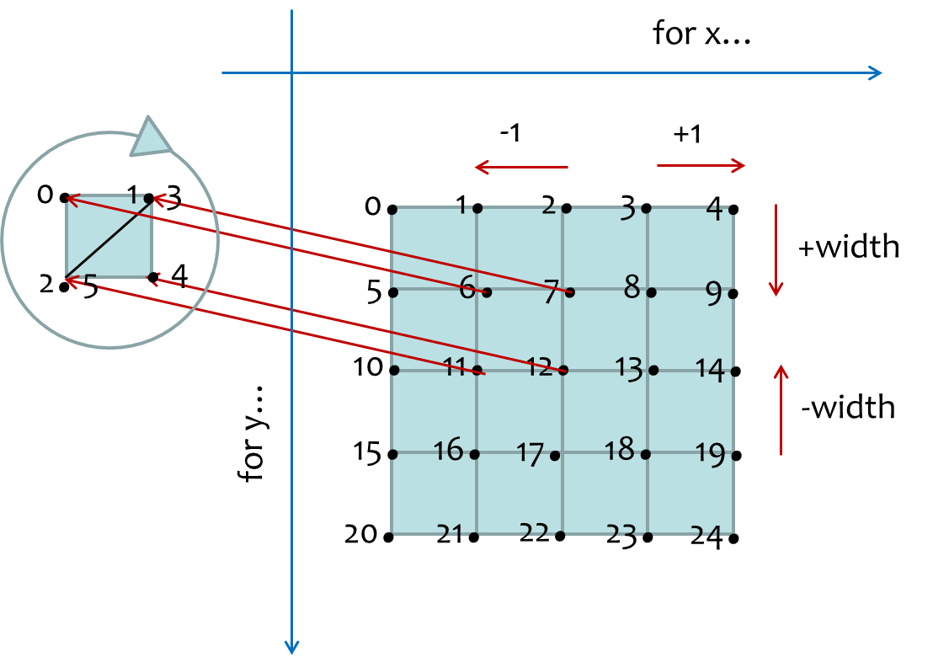
Tutorial Code Errata
This only makes any difference when you turn backface culling on, but for the sake of completeness...
Heightmap.cpp
Bug in LoadHeightMap
What we’ve told you about clockwise winding orders is correct....
But there is a bug in LoadHeightMap!
Bitmaps store data from bottom to top!
So the entire mesh needs to be flipped:
We should process the bitmap from bottom to top and flip in z
for(j = m_HeightMapLength-1; j >= 0 ; j--) {
for(i = 0; i < m_HeightMapWidth; i++) {
height = bitmapImage[k];
index = (m_HeightMapLength * j) + i;
m_pHeightMap[index].x = (float)(i - (m_HeightMapWidth / 2)) * gridSize;
m_pHeightMap[index].y = (float)height / 16 * gridSize;
m_pHeightMap[index].z = (float)((m_HeightMapLength / 2) - j) * gridSize;
k += 3;
}
}
The inverted mesh data turns clockwise into anti-clockwise!

